Slide 1

Electric
CSUN FSAE 2018 - 2019

Slide 2
Design Goals
Looking Ahead

Slide 3
Winter Break Goals
Implement wireless communication
Complete socket communication from embedded system to web application
CSV test values can provide mock data until real data can be provided
Create lap functionality
Web app and/or driver interface TDB
Complete driver display

Slide 4
Longer Term Goals
(First Quarter of Spring Semester)
Have embedded system successfully collecting and transmitting sensor data
Blocked until ME’s complete sensor implementation
Complete data acquisition hardware install
Blocked until parts arrive; ordered Monday
Determine if signal noise will be considerable or negligible problem and handle accordingly

Slide 5
Embedded Systems
Data Acquisition + Data Transmission

Slide 6
Progress Made
Setup container with dependencies
Configured ROS workspace
Storing data Sqlite (C++)
Sending data to Grafana (Nodejs)
Set up ROS messages (YAML)

Slide 7

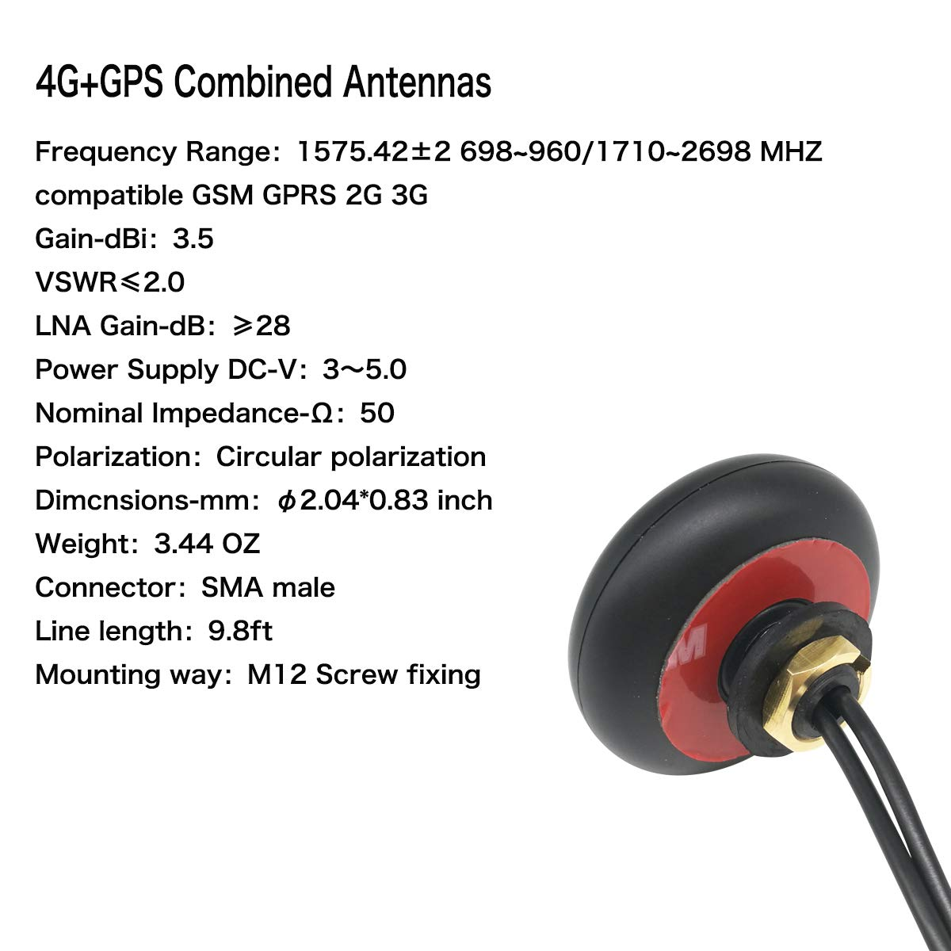
Wireless Communication - Changes
Moving away from local WiFi.
Twilio Programmable Wireless
4G LTE + T-Mobile Narrowband 4G (USA only)
Global 4G LTE / HSPA+ coverage + 3G/Edge
Why:
Removes need to carry instruments to connect to car and removes race -> cloud difficulties.
Car continues to have onboard WiFi for local recovery.

Slide 8
Winter Goals
Read data from DAQ card
Can Bus Communication
Receive data from Grafana

Slide 9
Web Software
Connected Car

Slide 10
Progress Made
Setup servers online through Digital Ocean
Refined Grafana pages to better represent data
Setup database models for all data sensors
Allowed for sending and receiving data through servers
Created test data based on previous races

Slide 11
Winter Goals
Continue to improve rate of data ingestion as well as data return.
Modify spec to meet changes from Embedded team
Develop the front end for the user display
Allow 2 way telemetry

Slide 12

Data Storage - Changes
Databases of choice
PostgreSQL + TimescaleDB
Time series data points from all sensors organized by data types
Timescale is a time series specialized database that offers faster performance for time series data. Offering a higher ingestion rate.
Why: In testing we discovered the presence of ingestion issues, leading to high CPU, Memory, R/W usage while Embedded team tested Socket connection.
Timescale removed heavy CPU & R/W usage. Memory usage maxed at 30% (Postgres + Timescale alone.)

Slide 13
Demo

Slide 14
THANKS!

